Slide 1

Lists as Stacks and Queues
SoftUni Team
Technical Trainers
Software University
https://softuni.bg

Slide 2
Table of Contents
Stacks
Creating Stacks
Adding Elements
Removing Elements
Queues
Creating Queues
Adding Elements
Removing Elements
2

Slide 3
Have a Question?
sli.do
#python-advanced

Slide 4

Stacks
LIFO

Slide 5
What is a Stack?
A stack is a linear data structure that stores items
The process of adding data to a stack is referred to as a "push"
Retrieving data from a stack is called a "pop"
Elements in a stack are added/removed from the top ("last in, first out") or LIFO order
5

Slide 6
Push to a Stack
10
2
5
0
1
2
Count:
3

Slide 7
Pop from a Stack
3
2
Count:
1
2
10
5

Slide 8
Stacks in Python
The list methods make it very easy to use a list as a stack
To add an item to the top of the stack, use append()
To retrieve an item from the top of the stack, use pop()
8

Slide 9

Stacks in Python: Example
stack = [3, 4, 5]
stack.append(6)
stack.append(7)
print(stack) # [3, 4, 5, 6, 7]
stack.pop() # 7
print(stack) # [3, 4, 5, 6]
stack.pop() # 6
stack.pop() # 5
print(stack) # [3, 4]
9

Slide 10
Problem: Reverse Strings
Write a program that reads a string, reverses it using stacks and prints the result on the console
I love Python
nohtyP evol I
Stacks and Queues
seueuQ dna skcatS
10

Slide 11

Solution: Reverse Strings
text = list(input())
stack = []
for i in range(len(text)):
stack.append(text.pop())
print("".join(stack))
11

Slide 12
Problem: Matching Parentheses
We are given an algebraic expression with parentheses
Scan through the string and extract each set of parentheses
Print the result back on the console
1 + (2 - (2 + 3) * 4 / (3 + 1)) * 5
(2 + 3)
(3 + 1)
(2 - (2 + 3) * 4 / (3 + 1))
12

Slide 13
Solution: Matching Parentheses
text = input()
parentheses = []
for i in range(len(text)):
if text[i] == "(":
parentheses.append(i)
elif text[i] == ")":
start_index = parentheses.pop()
print(text[start_index:i + 1])
13

Slide 14

Queues
FIFO

Slide 15
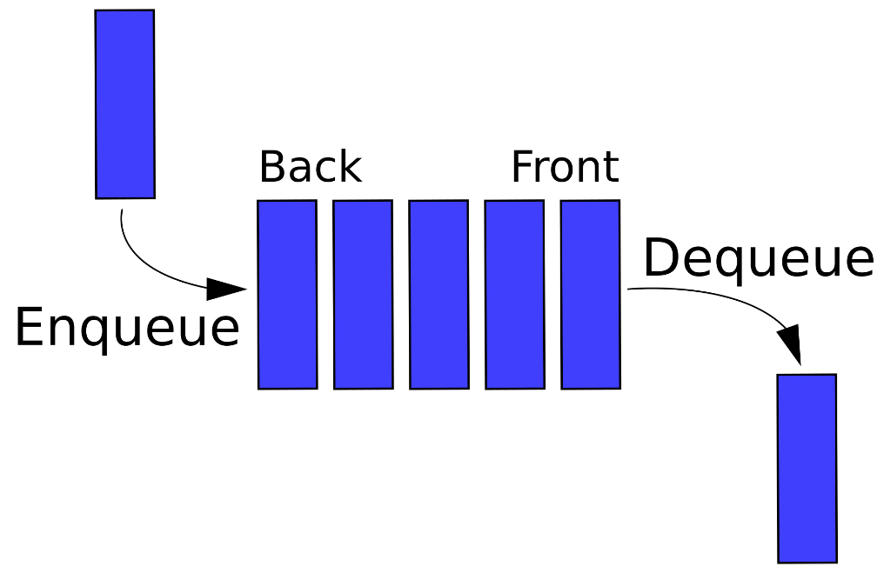
What is Queue?
A queue is a first-in first-out (FIFO) abstract data type
We use them when we want things to happen in the order that they were called
15

Slide 16
Enqueue
4
0
3
2
Count:
1
-3
5
15
121

Slide 17
Dequeue
4
2
Count:
3
121
15
-3
5

Slide 18
Queues in Python
It is possible to use a list as a queue, however they are not efficient for this purpose
Doing inserts or pops from the beginning of a list is slow
That's why we use collections.deque
We use append() to add to the queue and popleft() to remove from the queue
18

Slide 19
Queues in Python: Example
from collections import deque
queue = deque(["Eric", "John", "Michael"])
queue.append("Terry") # Terry arrives
queue.append("Graham") # Graham arrives
queue.popleft() # First leaves: 'Eric'
queue.popleft() # Second leaves: 'John'
print(queue) # ['Michael', 'Terry', 'Graham']
19

Slide 20
Problem: Supermarket
Read an input with a name and add it to a queue until "End"
If you receive "Paid", print every customer and empty the queue
When you receive "End" print the remaining people in the format: "{count} people remaining."
Anna
Michael
Simone
End
3 people remaining.
20

Slide 21
Solution: Supermarket
from collections import deque
queue = deque()
while True:
command = input()
if command == "Paid":
while len(queue):
print(queue.popleft())
elif command == "End":
print(f"{len(queue)} people remaining.")
break
else:
queue.append(command)
21

Slide 22
Problem: Water Dispenser
Read the problem description from the Lab Documents and test with the provided inputs
2
Peter
Amy
Start
2
refill 1
1
End
Peter got water
Amy got water
0 liters left
22

Slide 23
Solution: Water Dispenser
from collections import deque
queue = deque()
water_quantity = int(input())
name = input()
# add people to queue
command = input()
while command != "End":
if "refill" in command:
# increase liters
else:
liters = int(command)
if liters <= water_quantity:
water_quantity -= liters
print(f"{queue.popleft()} got water")
else:
print(f'{queue.popleft()} must wait')
command = input()
print(f"{water_quantity} liters left")
23

Slide 24

Practice
Live Exercise in Class (Lab)

Slide 25

Summary
Stack
LIFO data structure
Queue
FIFO data structure
Stack and Queue in Python

Slide 26
Questions?
Notes:
26

Slide 27












SoftUni Diamond Partners

Slide 28


Educational Partners

Slide 29

License
This course (slides, examples, demos, exercises, homework, documents, videos and other assets) is copyrighted content
Unauthorized copy, reproduction or use is illegal
© SoftUni – https://about.softuni.bg
© Software University – https://softuni.bg
Notes:
29

Slide 30
Trainings @ Software University (SoftUni)
Software University – High-Quality Education, Profession and Job for Software Developers
softuni.bg, softuni.org
Software University Foundation
softuni.foundation
Software University @ Facebook
facebook.com/SoftwareUniversity
Software University Forums
forum.softuni.bg
30
Notes:
30

